Slide 1

IMPLEMENTAREA CONCURENTEI IN LIMBAJE DE PROGRAMARE
Ioana Leustean
INTRODUCERE IN
ERLANG
http://www.erlang.org/

Slide 2

ACTOR MODEL
"Erlang's actor model can be imagined as a world where everyone is sitting alone in their own room and can perform a few distinct tasks. Everyone communicates strictly by writing letters and that's it. While it sounds like a boring life (and a new age for the postal service), it means you can ask many people to perform very specific tasks for you, and none of them will ever do something wrong or make mistakes which will have repercussions on the work of others; they may not even know the existence of people other than you (and that's great).
To escape this analogy, Erlang forces you to write actors (processes) that will share no information with other bits of code unless they pass messages to each other. Every communication is explicit, traceable and safe."
Varianta online
Fred Hébert, Learn You Some Erlang For Great Good
http://learnyousomeerlang.com/introduction#what-is-erlang

Slide 3
Bibliografie
Joe Armstrong, Robert Virding, Mike Williams, Concurrent Programming in Erlang, 1993
Joe Armstrong, Programming Erlang, Second Edition 2013
Fred Hébert, Learn You Some Erlang For Great Good, 2013
https://www.erlang.org/doc/

Slide 4
CONCURRENCY IN ERLANG
lightweight processes with
asynchronous message passing
Procesele in Erlang:
pot fi create si distruse rapid
comunica prin mesaje, iar comunicarea este rapida
sunt complet independente din punctul de vedere al memoriei

Slide 5
Concurenta in Erlang este implementata folosind urmatoarele primitive:
Pid = spawn (fun)
Pid = spawn (module, fct, args)
Pid ! Message
receive … end
https://www.erlang.org/doc/man/erlang.html#spawn-4

Slide 6
"Messages between Erlang processes are simply valid Erlang terms. That is, they can be lists, tuples, integers, atoms, pids, and so on.
Each process has its own input queue for messages it receives. New messages received are put at the end of the queue. When a process executes a receive, the first message in the queue is matched against the first pattern in the receive. If this matches, the message is removed from the queue and the actions corresponding to the pattern are executed.
However, if the first pattern does not match, the second pattern is tested. If this matches, the message is removed from the queue and the actions corresponding to the second pattern are executed. If the second pattern does not match, the third is tried and so on until there are no more patterns to test. If there are no more patterns to test, the first message is kept in the queue and the second message is tried instead. If this matches any pattern, the appropriate actions are executed and the second message is removed from the queue (keeping the first message and any other messages in the queue). If the second message does not match, the third message is tried, and so on, until the end of the queue is reached. If the end of the queue is reached, the process blocks (stops execution) and waits until a new message is received and this procedure is repeated."
http://erlang.org/doc/getting_started/conc_prog.html

Slide 7
Modelul Actori
Introdus de Carl Hewitt in 1973
Actorii sunt o notiune abstracta (corespunzatoare proceselor)
Actorii au memorie proprie, NU au memorie partajata
Actorii comunica prin mesaje
Un actor este capabil sa:
trimita mesaje actorilor pe care ii cunoaste
creeze noi actori
raspunda mesajelor pe care le primeste
Mesajele contin un destinatar si un continut
Trimiterea mesajelor este asincrona

Slide 8
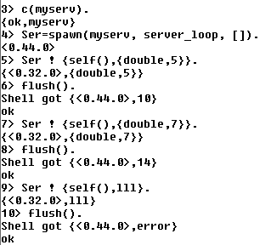
Cilent-Server (Exemplu simplu: doubling service)
Procesul Ser este serverul si
executa functia server_loop
Serverul primeste mesaje de la procese client si executa o actiune (dubleaza valoarea primita)
In acest exemplu singurul client este shell-ul
Mesajele primite de shell, adica raspunsurile trimise de server, sunt vizualizate cu flush()

Slide 9
Cilent-Server (Exemplu simplu: doubling service)
-module(myserv).
-export([server_loop/0]).
server_loop() ->
receive
{From, {double, Number}} -> From ! {self(),Number*2},
server_loop() ;
{From,_} -> From ! {self(),error},
server_loop()
end.

Slide 10
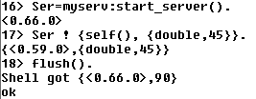
Cilent-Server : functie pentru pornirea server-ului
-module(myserv).
-export([server_loop/0]).
server_loop() ->
receive
{From, {double, Number}} -> From ! {self(), Number*2},
server_loop() ;
{From,_} -> From ! {self(),error},
server_loop()
end.
-export([start_server/0, server_loop/0]).
start_server() -> spawn(myserv, server_loop, []).

Slide 11
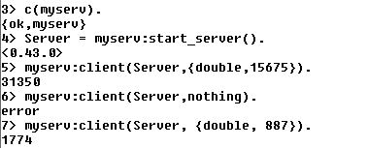
Cilent-Server: functia client
client(Pid, Request) ->
Pid ! {self(), Request},
receive
{Pid, Response} -> Response
end.
-module(myserv).
-export([start_server/0, server_loop/0,client/2]).
start_server() -> spawn(myserv, server_loop, []).
server_loop() ->
receive
{From, {double, Number}} -> From ! {self(),(Number*2)},
server_loop() ;
{From,_} -> From ! {self(),error},
server_loop()
end.
functia client intoarce raspunsul primit de la server
apelarea functiei client

Slide 12
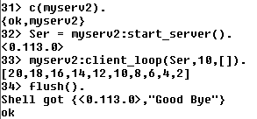
Client-Server
client_loop creaza mai multe procese client si intoarce lista rezultatelor
client_loop(Pid,0,L) -> Pid! {self(),"Good Bye"},
L;
client_loop(Pid, X, L) -> R= client(Pid,{double,X}),
client_loop(Pid, X-1, L++[R]).

Slide 13
Client-Server
client_loop creaza mai multi clienti si intoarce lista rezultatelor
client_loop(Pid,0,L) -> Pid! {self(),"Good Bye"},
L;
client_loop(Pid, X, L) -> R= client(Pid,{double,X}),
io:fwrite("prel ~w!~n", [X]),
client_loop(Pid, X-1, L++[R]).
Functiile client sunt executate secvential!

Slide 14
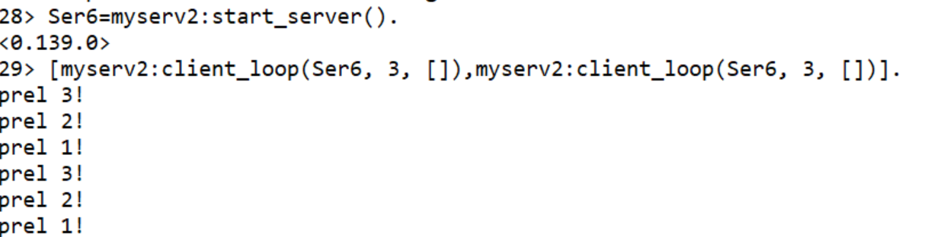
Client-Server
client_loop creaza mai multi clienti si intoarce lista rezultatelor
client_loop(Pid,0,L) -> Pid! {self(),"Good Bye"},
L;
client_loop(Pid, X, L) -> R= client(Pid,{double,X}),
io:fwrite("prel ~w!~n", [X]),
client_loop(Pid, X-1, L++[R]).
Functiile client sunt executate secvential!

Slide 15
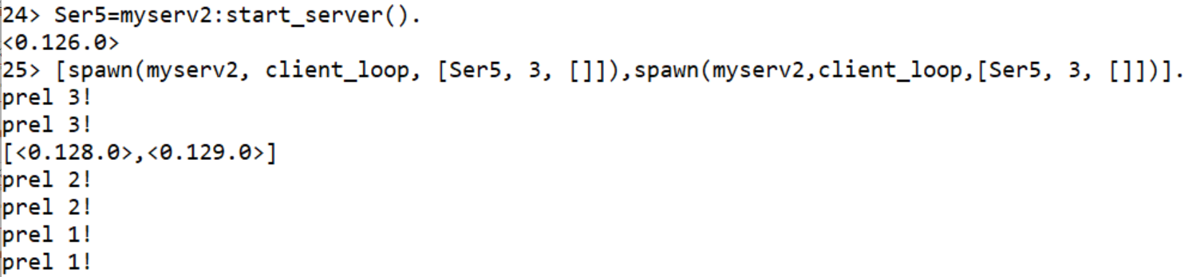
Client-Server
client_loop creaza mai multi clienti si intoarce lista rezultatelor
client_loop(Pid,0,L) -> Pid! {self(),"Good Bye"},
L;
client_loop(Pid, X, L) -> R= client(Pid,{double,X}),
io:fwrite("prel ~w!~n", [X]), client_loop(Pid, X-1, L++[R]).
Functiile client sunt executate in paralel!

Slide 16
Client-Server
procesele client se executa in paralel
si se intoarce lista rezultatelor
worker(Parent, Pid, Number) -> spawn( fun() ->
Result = client (Pid,{double,Number}),
Parent ! {self(),Result}
end ).
calls (Pid,N) -> Parent = self(),
Pids = [worker(Parent,Pid, X) || X <- lists:seq(1,N)],
[ wait_one(P) || P <- Pids ].
wait_one (Pid) ->
receive
{Pid,Response} -> Response
end.
% Pid este id-ul procesului server
% Parent este id-ul procesului care creaza clientii
% worker creaza un proces client si intoarce id-ul acestuia

Slide 17
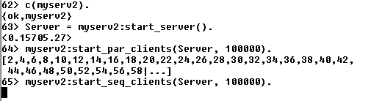
Client-Server
start_server() -> spawn(myserv, server_loop, []).
start_seq_clients(Pid, N) -> client_loop(Pid,N,[]).
start_par_clients(Pid, N) -> calls(Pid,N).

Slide 18
Client-Server
unui proces i se poate asocia un nume (atom) folosind register
myserv3.erl
start_server() -> register(serv, spawn(fun() ->server_loop() end)).
server_loop() ->
receive
{From, {double, Number}} -> From ! {serv,(Number*2)},
server_loop() ;
{From, "Good Bye"} -> From! {serv,"Good Bye"},
server_loop();
{From,_} -> From ! {serv,error},
server_loop()
end.
procesul server are numele serv

Slide 19
Registered process
register (Name, Pid) asociaza numele Name procesului cu id-ul Pid
Name este atom si este "eliberat" cand procesul se termina
whereis(Name) intoarce id-ul procesului inregistrat cu Name
(sau undefined daca nu exista)
Processes — Erlang System Documentation v27.2
start_server() -> register(serv, spawn(fun() ->server_loop() end)).

Slide 20
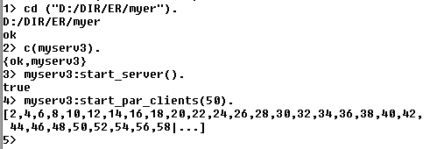
Client-Server
start_par_clients(N) -> calls(N).
worker(Parent, Number) ->
spawn( fun() ->
Result = client ({double,Number}),
Parent ! {self(),Result}
end ).
calls (N) ->
Parent = self(),
Pids = [worker(Parent,X)|| X <- lists:seq(1,N)],
[waitone(P)|| P <- Pids].
waitone (Pid) ->
receive
{Pid,Response} -> Response
end.
client(Request) ->
serv ! {self(), Request},
receive
{serv, Response} -> Response
end.

Slide 21
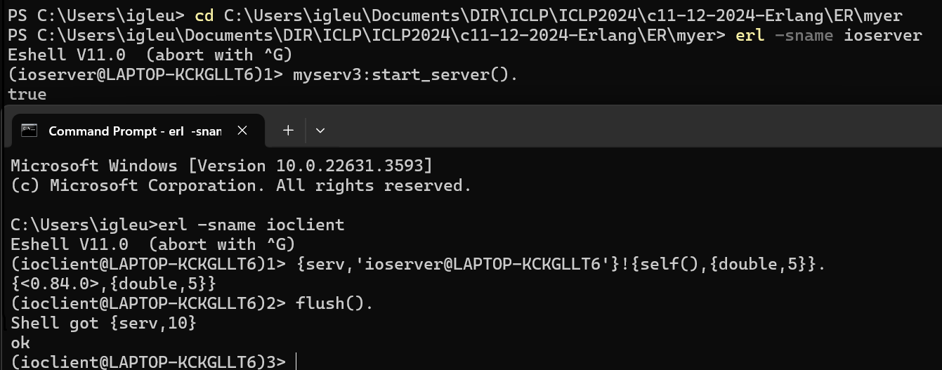

Distributed Erlang: programele ruleaza in noduri diferite
>erl –sname ioserver
Crearea unui nod in Erlang
>erl –sname …
>erl –sname ioclient
Numele e atom!

Slide 22
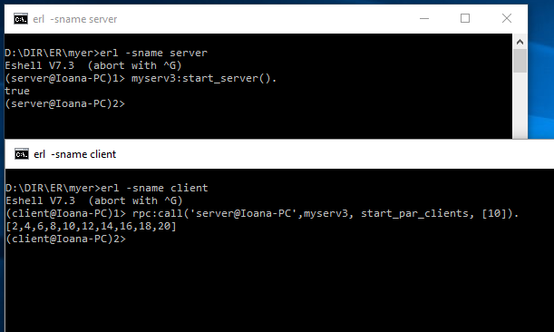
Distributed Erlang: programele ruleaza in noduri diferite
Crearea unui nod in Erlang
>erl –sname …
rpc:call
remote procedure call
http://erlang.org/doc/man/rpc.html#call-4

Slide 23
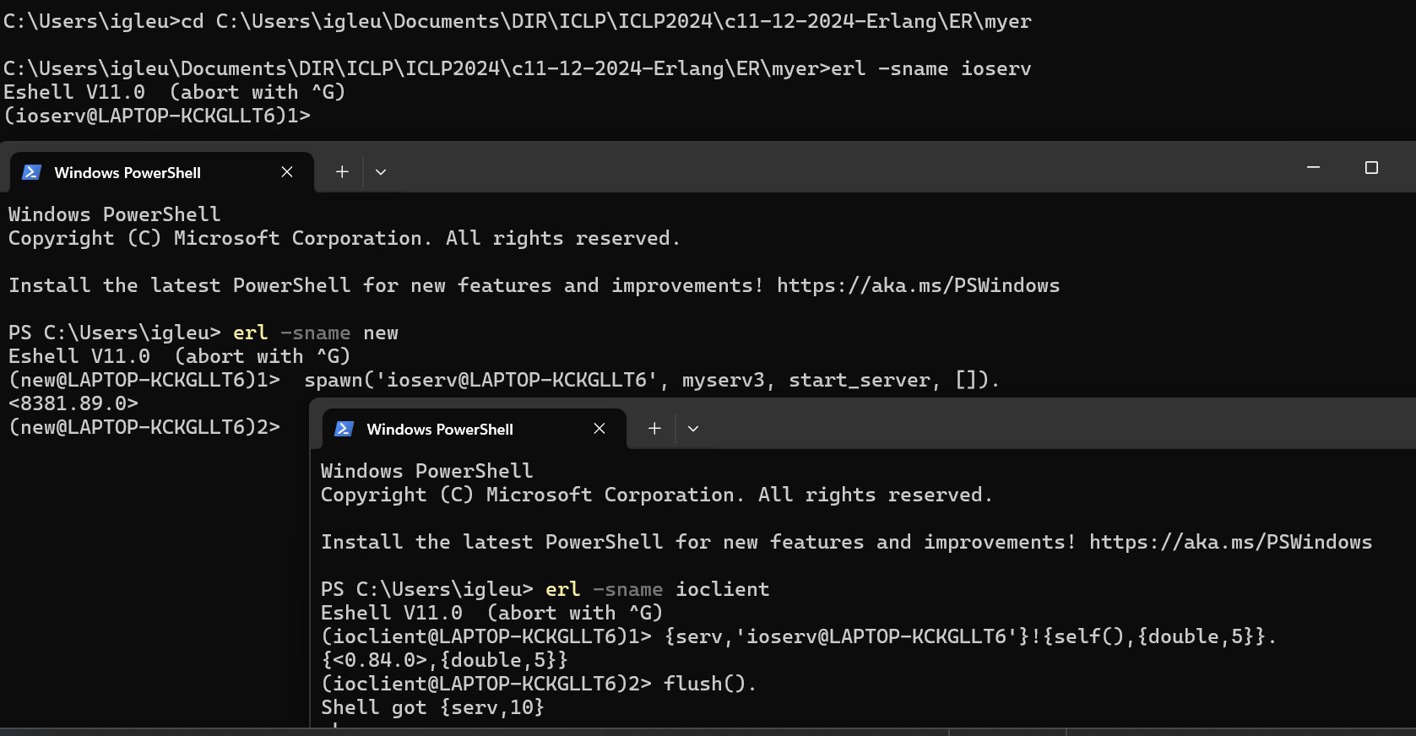
Distributed Erlang: programele ruleaza in noduri diferite
cu spawn/4 serverul este pornit din alt nod
https://www.erlang.org/doc/apps/erts/erlang#spawn/4

Slide 24
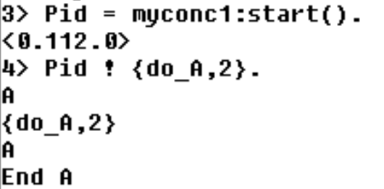
?MODULE
macro (definit de sistem) care intoarce numele modulului curent
start() -> spawn(?MODULE, myrec, []).
myrec() ->
receive
{do_A, X} -> prelA(X);
{do_B, X} -> prelB(X);
_ -> io:format("Nothing to do ~n")
end.

Slide 25
Cilent-Server (simple) template
-module(servtemplate).
-compile(export_all).
start_server() -> register(serv,spawn(?MODULE, server_loop, [])).
server_loop() ->
receive
…..
{From, Request} -> From ! {serv, Response} ,
server_loop()
end.
client(Request) ->
serv ! {self(), Request},
receive
{serv, Response} -> Response
end.
tail recursion

Slide 26
Concurenta in Erlang este implementata folosind urmatoarele primitive:
Pid = spawn (fun)
Pid = spawn (module, fct, args)
Pid ! Message
receive … end
receive … after … end

Slide 27
receive … after … end
La intrarea in receive, daca exista un after, se porneste un timer.
Mesajele din coada sunt investigate in ordinea sosirii; daca un mesaj se potriveste cu un pattern atunci expresia corespunzatoare este prelucrata.
Mesajele care nu se potrivesc cu nici un pattern sunt puse intr-o coada separate (save queue).
Daca nu mai sunt mesaje in coada procesul se suspenda si asteapta venirea unui nou mesaj; la venirea acestuia, numai el este prelucrat, nu si mesajele din save queue.
Cand un mesaj se potriveste cu un pattern, mesajele din save queue sunt puse la loc in coada si timerul se sterge.
Daca timpul T s-a scurs fara ca un mesaj sa se potriveasca unui pattern, atunci ExpressionT se executa, iar mesajele din save queue sunt puse inapoi in coada.
receive
Pattern1 when Guard1 -> Expr1;
Pattern2 when Guard2 -> Expr2;
Pattern3 -> Expr3
…
after T ->
ExpressionT
end

Slide 28
receive … after … end
flush() ->
receive
_ -> flush()
after 0 ->
ok
end.
sleep(T) ->
receive
after T ->
ok
end.
orice mesaj se potriveste cu patternul, deci
apelul recursiv va goli coada de mesaje, dupa
care procesul va continua
instructiunea
nu exista sabloane, deci niciun mesaj
nu va fi acceptat;
procesul va fi blocat T milisecunde
after 0 -> …
verifica coada de mesaje si apoi continua;
daca aceasta clauza lipseste, procesul se
va bloca cand coada de mesaje se goleste

Slide 29
flush()
receive cu prioritate
important() ->
receive
{Priority, X} when Priority > 10 -> [X|important()] after 0 ->
normal()
end.
normal() ->
receive
{_,X} -> [X|normal()]
after 0 -> []
end.
flush() ->
receive
_ -> flush()
after 0 ->
ok
end.
Varianta a functiei flush() care
ordoneaza mesajele dupa prioritati

Slide 30
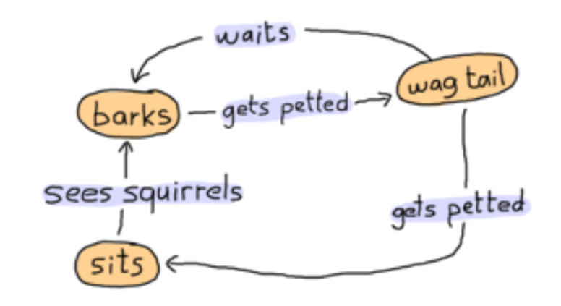
Implementarea unui automat finit
(Finite-State Machine)
Starile ={barks, sits, wag_tail}
Actiunile ={gets_petted, see_squirrels, waits}
dog as a state-machine
http://learnyousomeerlang.com/finite-state-machines#what-are-they

Slide 31

Implementarea unui automat finit
-module(dog_fsm).
-export([start/0, squirrel/1, pet/1]).
start() ->
spawn(fun() -> bark() end). % starea initiala
%actiunea see_squirrels
squirrel(Pid) -> Pid ! squirrel.
%actiunea gets_petted
pet(Pid) -> Pid ! pet.
actiunile sunt implementate prin mesaje si
sunt vizibile in exterior

Slide 32
Finite-StateMachine: implementarea starilor
bark() ->
io:format("Dog says: BARK! BARK!~n"),
receive
pet -> wag_tail();
_ -> io:format("Dog is confused~n"),
bark()
after 2000 -> bark()
end.

Slide 33
Automat finit: definirea starilor
wag_tail() ->
io:format("Dog wags its tail~n"),
receive
pet -> sit();
_ -> io:format("Dog is confused~n"),
wag_tail()
after 30000 ->
bark() % actiunea waits
end.

Slide 34
Automat finit: definirea starilor
sit() ->
io:format("Dog is sitting. Gooooood boy!~n"),
receive
squirrel -> bark();
_ -> io:format("Dog is confused~n"),
sit()
end.

Slide 35
Implementarea unui automat finit
http://learnyousomeerlang.com/finite-state-machines#what-are-they

Slide 36
Schimb de mesaje cu transmiterea starii
(message passing with data storage)
Procesul (serverul) este un frigider care accepta doua tipuri de comenzi
- depoziteaza alimente,
- scoate alimente .
Acelasi aliment poate fi depozitat de mai multe ori si
poate fi scos de cate ori a fost depozitat.
La fiecare moment trebuie sa stim ce alimente se gasesc in frigider
(starea procesului).
Starea procesului se transmite prin parametrii functiilor.
kitchen.erl
http://learnyousomeerlang.com/

Slide 37
Schimb de mesaje cu transmiterea starii
fridgef(FoodList) ->
receive
% comanda store
% comanda take
….
end.
store(Pid, Food) ->
Pid ! {self(), {store, Food}},
receive
{Pid, Msg} -> Msg
end.
take(Pid, Food) ->
Pid ! {self(), {take, Food}},
receive
{Pid, Msg} -> Msg
end.
kitchen.erl
http://learnyousomeerlang.com/

Slide 38
Mesaje cu transmiterea starii
kitchen.erl
http://learnyousomeerlang.com/
fridgef(FoodList) ->
receive
{From, {store, Food}} -> From ! {self(), ok}, fridgef([Food|FoodList]);
{From, {take, Food}} -> case lists:member(Food, FoodList) of true -> From ! {self(), {ok, Food}},
fridgef(lists:delete(Food, FoodList)); false -> From ! {self(), not_found}, fridgef(FoodList)
end;
terminate -> ok
end.

Slide 39
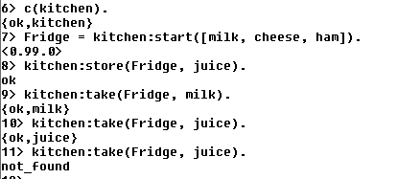

Slide 40
Varianta: registered process, comenzile show (pentru a vizualiza starea) si terminate
start(FoodList) -> register(fridge, spawn(fun()-> fridgef(FoodList) end)).
show() ->
fridge ! {self(), show},
receive
{fridge, Msg} -> Msg
end.
terminate() ->
fridge ! {self(), terminate},
receive
{fridge, Msg} -> Msg
end.
store(Food) ->
fridge! {self(), {store, Food}},
receive
{fridge, Msg} -> Msg
end.
take( Food) ->
fridge ! {self(), {take, Food}},
receive
{fridge, Msg} -> Msg
end.

Slide 41
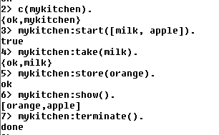
Varianta: registered process, comenzile show (pentru a vizualiza starea) si terminate
fridgef(FoodList) ->
receive
{From, {store, Food}} -> From ! {fridge, ok},
fridgef([Food|FoodList]);
{From, {take, Food}} ->
case lists:member(Food, FoodList) of
true -> From ! {fridge, {ok, Food}},
fridgef(lists:delete(Food, FoodList));
false -> From ! {fridge, not_found},
fridgef(FoodList)
end;
{From,show} -> From ! {fridge, FoodList},
fridgef(FoodList);
{From,terminate} -> From ! {fridge, done}
end.
mykitchen.erl
fara apel recursiv

Slide 42
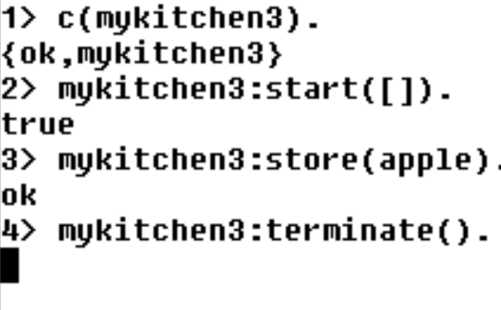
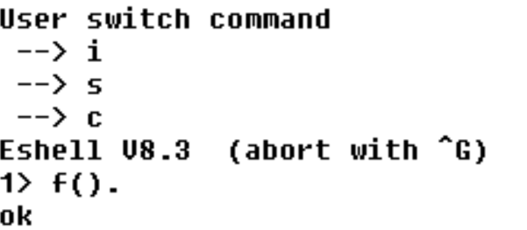
mykitchen3.erl
fridgef(FoodList) ->
receive
{From, {store, Food}} -> From ! {fridge, ok},
fridgef([Food|FoodList]);
{From, {take, Food}} ->
case lists:member(Food, FoodList) of
true -> From ! {fridge, {ok, Food}},
fridgef(lists:delete(Food, FoodList));
false -> From ! {fridge, not_found},
fridgef(FoodList)
end;
{From,show} -> From ! {fridge, FoodList},
fridgef(FoodList)
end,
io:format("al doilea receive~n"),
receive
{From,terminate} -> From ! {fridge, done}
end.
procesul este blocat
pentru ca nu poate iesi din
primul receive
Ctrl-G deblocheaza shell-ul
f() dezleaga variabilele
http://erlang/doc/man/shell.html

Slide 43
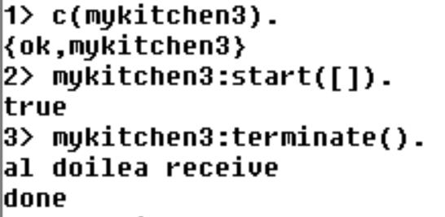
receive … after … end
fridgef(FoodList) ->
receive
{From, {store, Food}} -> From ! {fridge, ok},
fridgef([Food|FoodList]);
{From, {take, Food}} ->
case lists:member(Food, FoodList) of
true -> From ! {fridge, {ok, Food}},
fridgef(lists:delete(Food, FoodList));
false -> From ! {fridge, not_found},
fridgef(FoodList)
end;
{From,show} -> From ! {fridge, FoodList},
fridgef(FoodList)
after 30000 -> timeout
end,
io:format("al doilea receive~n"),
receive
{From,terminate} -> From ! {fridge, done}
end.
dupa 30 sec
in apelul terminate(), procesul shell asteapta
mesaj de la fridge pentru receive din terminate()
apelul functiei terminate() se incheie numai dupa
ce trec cele 30 sec si poate fi prelucrat mesajul
"terminate" in al doilea receive din fridgef()
terminate() ->
fridge ! {self(), terminate},
receive
{fridge, Msg} -> Msg
end.

Slide 44
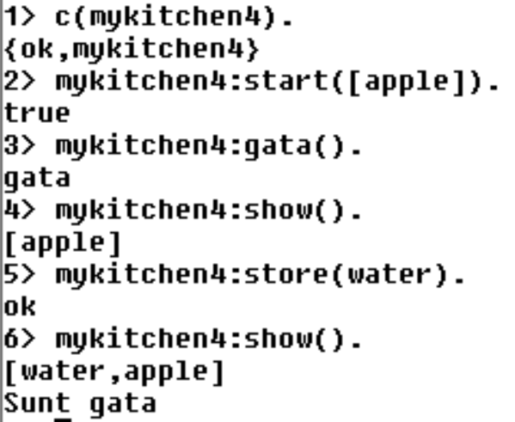
receive … after … end
fridgef(FoodList) ->
receive
{From, {store, Food}} -> From ! {fridge, ok},
fridgef([Food|FoodList]);
{From, {take, Food}} ->
case lists:member(Food, FoodList) of
true -> From ! {fridge, {ok, Food}},
fridgef(lists:delete(Food, FoodList));
false -> From ! {fridge, not_found},
fridgef(FoodList)
end;
{From,show} -> From ! {fridge, FoodList},
fridgef(FoodList);
{From,terminate} -> From ! {fridge, done}
after 30000 -> timeout
end,
receive
gata -> io:format("Sunt gata~n")
end.
functia gata() intoarce imediat,
shell-ul nu ramane blocat
se pot trimite mesaje serverului
mesajul gata este prelucrat dupa ce au trec 30 sec
fara o comanda prelucrata de primul receive
gata() -> fridge ! gata

